Slide 1
Phoenix Advisors’ data: Revealing insights and results.

Slide 2
Oops!!! Data has some anomalies!

Slide 3
Anomalies in the data.
Advisors Details Dataset
3 people have anomalous date of birth.
Transaction Details Dataset
Some of the sales transactions had negative values.
1374 out of 15,020 values (9.15%)
Some of the redemption transactions had positive values.
1476 out of 13,563 values (10.88%)

Slide 4
Dive inside: Important Insights

Slide 5
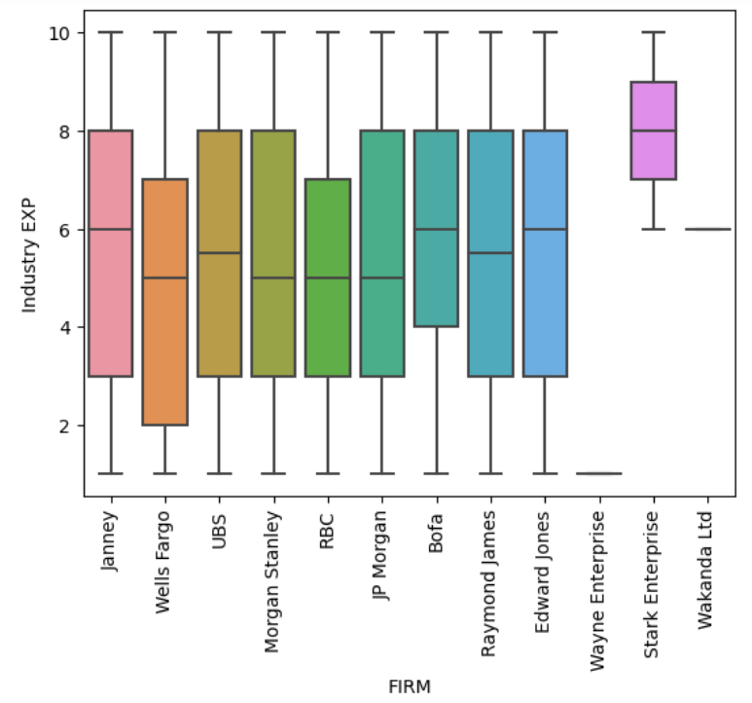
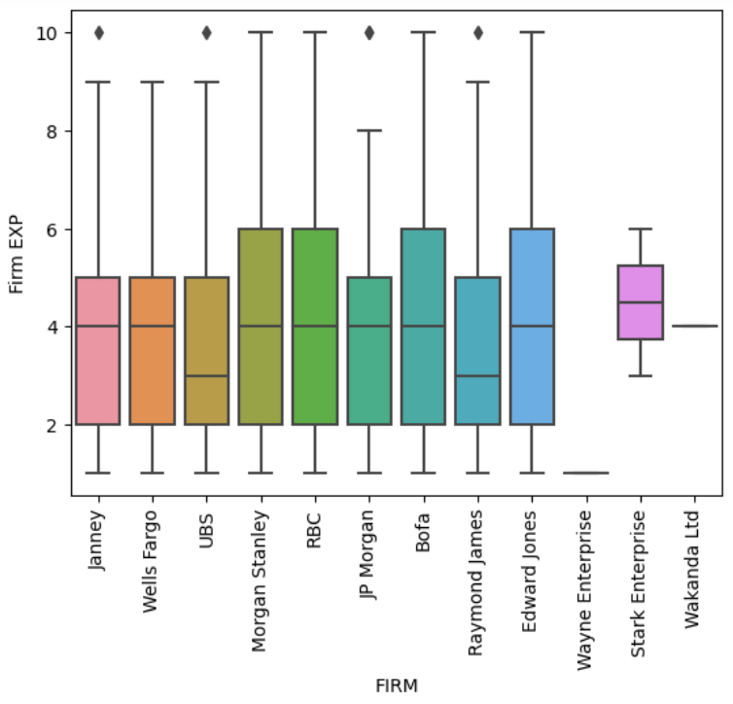
Have a look at the Industry and Firm Experience

Slide 6
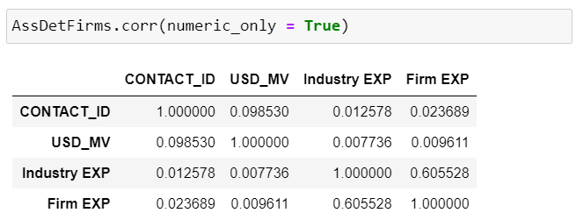
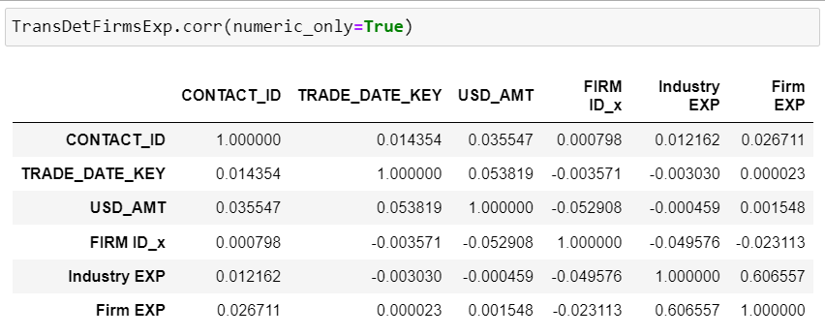
Do they any how relate to the overall performance?

Slide 7
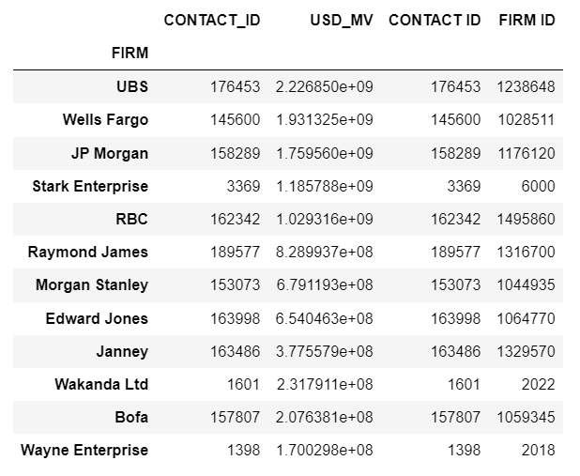
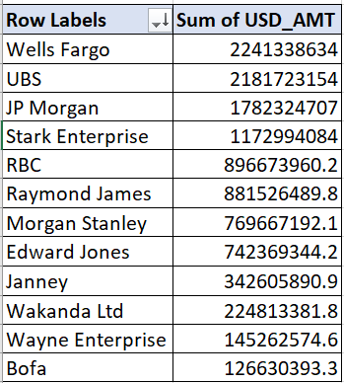
Firms based on AUM and Net Sales

Slide 8
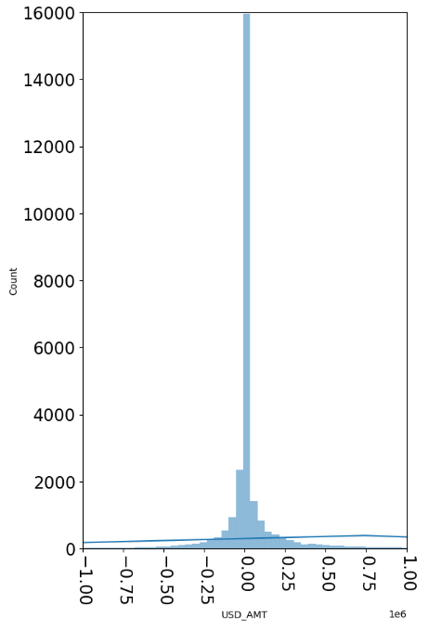
HISTOGRAM OF TRANSACTION VALUE IN USD.
The transaction amount values belong to lower ranges though the maximum and minimum values cross the bounds.
The positive values
Min: 1.70e-13
Max: 2.88e+8
Median: 18540.64
Mean: 1.24e+6
The negative values
Min: -1.58e+8
Max: -1.33-12
Median: -4952.71
Mean: -5.34e+5

Slide 9
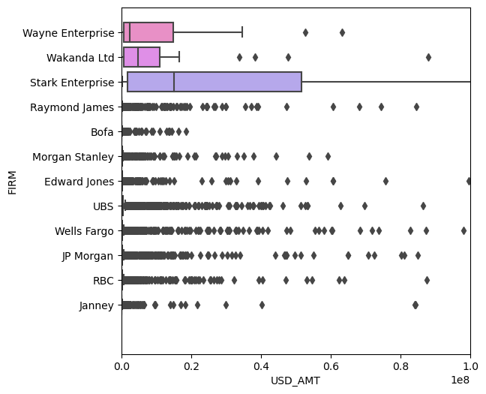
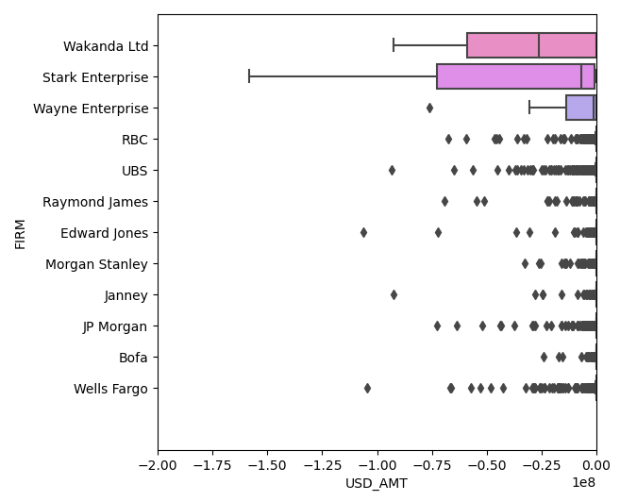
Identifying that ‘big’ chunk

Slide 10
Advisors of Stark, Wayne and Wakanda
Stark Enterprise
Wayne Enterprise
Wakanda Ltd
2
Advisors
1
Advisors
1
Advisors

Slide 11
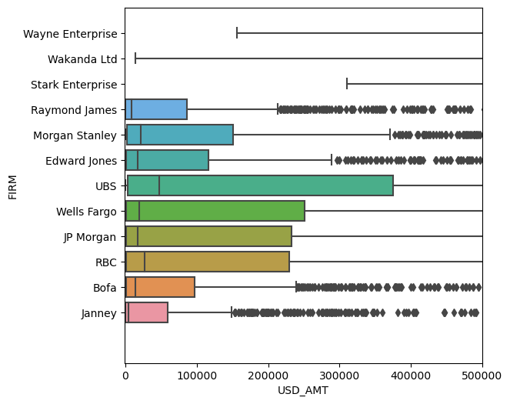
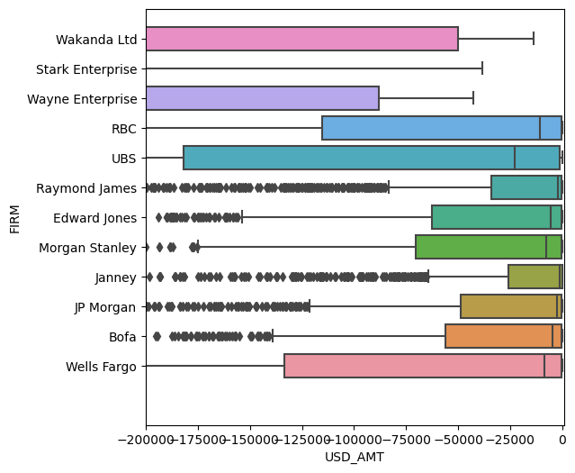
Now a closer look!!!

Slide 12
The client’s essential

Slide 13

Who all can be contacted for the email campaign?
The below dataset contains the list of all the advisors who:
Have seen deprecation of average value of asset in the second half of the time period compared to the first half.
Who have a primary email ID in order to send an email.
Who are at least once contacted by the Sales Team through email.
Those who did not block themselves.
428/1000
ADVISORS WHO ARE ELIGIBLE FOR THE EMAIL CAMPAIGN.

Slide 14
